Slide 2
E-Krishi
Submitted to: Prof. Priyanka Jangde
Department of Computer Science and Engineering

Slide 3
Supervised by: Prof. Priyanka Jangde
Team Members
1. Aanya Chourasiya (0827CS201003)
2. Aayushi Jain (0827CS201007)
3. Abhay Gour (0827CS201009)
4. Ankur Nagar (0827CS201035)

Slide 4
Acknowledgment
We would like to extend our heartfelt gratitude to our Computer Science and Engineering department for providing us with this great opportunity to work on this project.
We would also like to express our sincere gratitude to Prof. Priyanka Jandge for her valuable guidance and kind supervision throughout the course of this project.

Slide 5
Project Presentation Outline
Abstract
Introduction
Problem Statement
Survey of Existing Systems
Project Objectives
Requirement Analysis
Use case Diagram
Solution Proposed
The Outcome Discussion
Conclusion and Limitations

Slide 6
Introduction
Agriculture still forms the backbone of the Indian economy and there is always a need to support and improve it. As a part of which some of Indian NGOs are with an initiative of supporting the farmers by facilitating them with the modern agricultural equipment on rental basis . At present, farmers need to travel to a place to borrow all the essential needs, which is a tiresome and not a cost effective work. Therefore, we aim at developing a Website that farmers can use to get their equipment on rent and also check the availability and renting.
Conservation of biodiversity in terms of grain storage nowadays is essential due to cultural heritage and health of the state. Post-harvest losses account for about 10 per cent of the total food grains due to unscientific storage, insects, rodents, microorganisms etc. After reviewing academic and technical literature it was found that traditional approaches are also significantly important for grain storage in India.

Slide 7
Abstract
This presentation is about digitizing the process of renting agricultural equipment to farmers and providing them with an efficient crop storage system. Our goal is to develop a website that farmers can use to get their rental equipment and also check availability and rental storage centers. We also enable them to reserve the equipment in advance. It also helps us to get an overview of the equipment that is being rented.
This web-based agricultural equipment and storage rental system is very user-friendly. This website contains complete and up-to-date device and storage information. Users can access the website by entering their username and password. Users can access this website at any time. We primarily design this website for disadvantaged farmers. As a result, they cannot purchase all types of devices and some of them even don’t have an efficient storage facility for harvest. As a result, we strive to provide efficient rental equipment and storage services.

Slide 8
The Problem Statement
The problems we are addressing are :
Most of the farmers are not that much capable enough to buy equipment for farming. Due to which they have to do that work manually which will consume lot of time and effort. And if there is any facility to rent it they first need to search for it which is not an easy task. So, in order to resolve these problems we are developing a renting system.
After the crop has been grown, the next important task is to store it in appropriate place, in appropriate weather with minimal cost. Since farmers have to search for warehouse by their own, there can be chances that they won't find the warehouse or successfully found it but with higher rent. Our website will solve this problem along with it, using our website farmers will get up-to-date information about the price of crops in market place.
India till now is not a fully literate country. What if farmers won't be able to use the website due to their absence of technical knowledge. Hence, our approach will be towards maintaining a audio based assistant which will guide the farmers throughout.
Pesticides are needed to protect the crops from pests; fertilizers are needed to increase the fertility of the crop. Big-big companies make these materials, where some company costs higher and some lower. So in order to resolve it we will make a recommendation for pesticides, fertilizer and crops which will recommend the pesticides, fertilizer and crops with lower cost quantity needed and how to use that.

Slide 9
Survey of Existing Systems
The existing system for rental equipment for farmers typically involves a network of rental equipment companies and dealers who offer a variety of farming equipment for rent. Some key elements of the existing system include:
Equipment inventory: Rental companies maintain a wide range of farming equipment, including tractors, planting equipment, harvesting equipment, and livestock equipment, among others.
Rental agreements: Rental companies typically have clear and concise rental agreements, which outline the terms of the rental, including the rental period, rental fee, and any restrictions or limitations on equipment use.
Delivery and pickup: Rental companies typically offer delivery and pickup services for rented equipment, making it easy for farmers to obtain the equipment they need.
Maintenance and repair: Rental companies typically handle all necessary maintenance and repair work for the equipment they rent out, ensuring that it is in good working condition at all times.
Insurance: Rental companies typically provide insurance for the equipment they rent out, providing farmers with peace of mind in the event of any damage or loss.
Customer support: Rental companies typically have customer support teams available to answer any questions or concerns that farmers may have during the rental period.

Slide 10
Survey of Existing Systems
The existing system for rental storage facilities for farmers typically involves a network of storage facilities operators and real estate companies who offer a variety of storage options for farmers. Some key elements of the existing system include:
Storage units: Rentable storage facilities typically include a range of unit sizes and types, including outdoor storage yards, indoor storage units, and climate-controlled units.
Rental agreements: Storage facilities typically have clear and concise rental agreements, which outline the terms of the rental, including the rental period, rental fee, and any restrictions or limitations on unit access.
Security: Most rental storage facilities have security measures in place, including gated access, surveillance cameras, and secure locks, to protect stored items from theft or damage.
Convenient location: Rental storage facilities are typically located in convenient locations, close to major roads and highways, making it easy for farmers to access their stored items.
Customer support: Storage facilities typically have customer support teams available to answer any questions or concerns that farmers may have during the rental period.

Slide 11
Objectives
Our goal is to develop a website that farmers can use to rent equipment and also check availability of storage centers for crops.
It reduces the cost of visiting hubs to check availability storage centers and rental equipment.
We also allow them to book equipment and storage centers in advance.
It also helps us to get an overview of the equipment that is rented.
We also aim to ensure better equipment availability and equipment health monitoring which could also help in providing better support to farmers.

Slide 12
Requirement Analysis
The requirement of the resources for designing and developing the E-Commerce website are as follows:
Windows computer or Linux
Python Version 3.6 or above
Python Installed Windows Operating system or Linux OS Machine
HTML
CSS
Javascript
ReactJS
NodeJS
ExpressJS
MongoDB

Slide 13
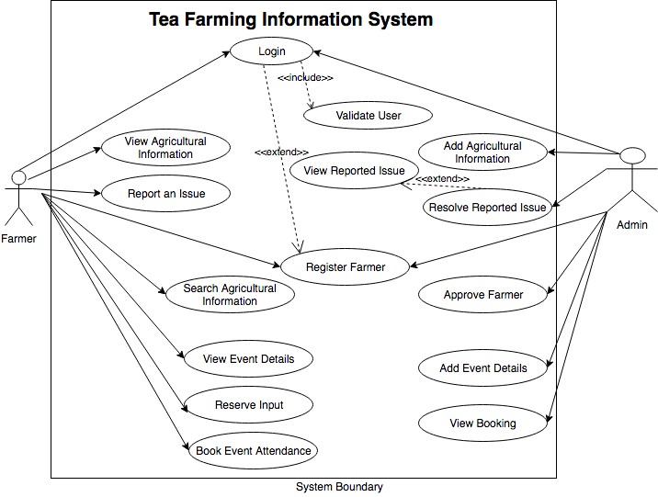
USE CASE DIAGRAM
USE CASE DIAGRAM

Slide 14
Solution Proposed
The aim of the proposed system is to develop a website for the farmers in order to help them in several domains. Our website will perform the following functions:
A website that farmers can use to rent equipment and also check its availability.
Farmers can check the price and temperature for storing final goods in the warehouse and can book it. They can also check the rate of crops currently running in the market and can sell it using our website.
It may be possible that the user is not literate enough so in order to make it interactive we will add an audio based assistant.
Our website will recommend what to sow with what in order to increase productivity and fertility.
A recommendation system for pesticides,crops and fertilizers.

Slide 15
The Outcome Discussion
Farmers who are not financially able to purchase equipment can take it on rent using our website.
Farmers will be able to get the information of vacant warehouses according to the quantity of the material and the temperature needed to store the crops which will lower the searching process and efforts.
If the owner of the warehouse is providing a better selling price than the marketplace, then the farmers will have the option to sell it to the owner itself. Overall the farmer can analyze the future circumstances.
Audio based assistant will direct the farmer.
Half vacant farm lands can lead to soil erosion and decrease in productivity and fertility. In order to increase it, our website will recommend what to sow to avoid such problems.
It will include recommendation system in following domain:
Which pesticide will go with what crop and in how much quantity. Recommending pesticides with its price.
Recommendation of appropriate crop according to the region, soil and season.
If there is any shortage of urea then the site will recommend its availability zone.

Slide 16
Conclusion and Limitation
Limitations :
There should be a proper network area to access the internet.
Farmers should at least know how to use mobile phones.
Farmers should be educated.
It would be tough for us to find some rental equipment.
Equipment cost may be higher for some farmers.
Storage areas may be region specific; warehouses are not mentioned for all regions.
In conclusion, the rental equipment and storage facilities for farmers project is a promising initiative that has the potential to bring significant benefits to farmers, suppliers, and the agriculture industry as a whole. By providing farmers with increased access to equipment and storage facilities, as well as improved efficiency and cost savings, the project will help farmers to grow and succeed in their operations. Additionally, by improving supplier management and enhancing the customer experience, the project will help to drive increased adoption and usage of the system over time. While the project may face challenges and limitations, including time and budget constraints, user adoption, and market conditions, careful planning and management will be key to ensuring its success. Overall, the rental equipment and storage facilities for farmers project has the potential to make a meaningful impact on the agriculture industry, and is a valuable opportunity to support and strengthen the industry for years to come. The proper documentation of complete mission is also supplied so that any-you can recognize the project and may do the vital Adjustments if required. This application may be advanced in many methods and may be extended to guide multiple devices. Inclusion of crops and fertilizers to the list. In Recommendation system this website will suggest cost, storage information , fertilizers and pesticides according to farmers needs by using machine learning it pop up the website. In additional to all of that there would be auto guided audio system to make our website more interactive to easily help farmers to understand and guide.

